Slide 1
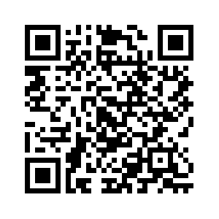



SWARM-SLR – Streamlined Workflow Automation for Machine-actionable Systematic Literature Reviews
24.09.2024 • Tim Wittenborg • L3S Research Center, Hannover
available online,
same QR code on all slides

Slide 2
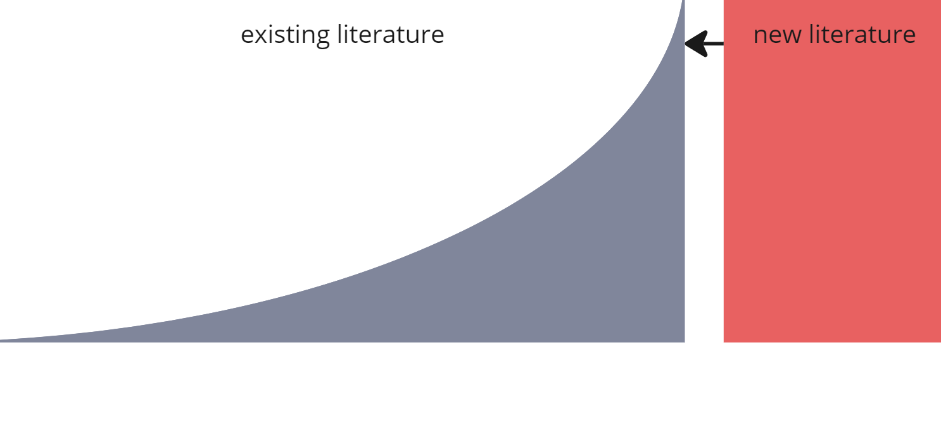
Problem:
Too many publications
Too many tools
Millions of new publications each year at a steadiliy increasing trend [1]
Solution: efficient literature review support
Hundreds of tools supporting different tasks without overview or cohesion [2]
Solution: streamlined workflow automatization
[1] Bornmann, L., Mutz, R.: Growth rates of modern science: A bibliometric analysis based on the number of publications and cited references. Journal of the Association for Information Science and Technology 66(11), 2215–2222 (2015). https://doi.org/10.1002/asi.23329
[2] Bosman, J., Kramer, B.: 400+ Tools and innovations in scholarly communication - data collection forms (2023), https://docs.google.com/spreadsheets/d/1KUMSeq_Pzp4KveZ7pb5rddcssk1XBTiLHniD0d3nDqo/edit
24.09.2024 • SWARM-SLR at TPDL • Tim Wittenborg
Notes:
Introduce the issue

Slide 3
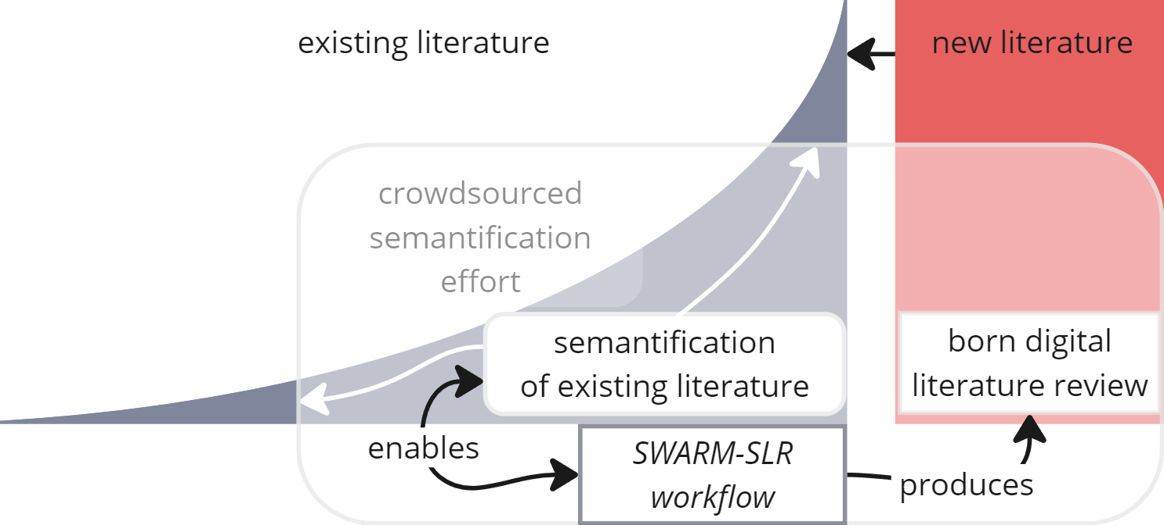
Problem:
Too many publications
Too many tools
Millions of new publications each year at a steadiliy increasing trend [1]
Solution: efficient literature review support
Hundreds of tools supporting different tasks without overview or cohesion [2]
Solution: streamlined workflow automatization
[1] Bornmann, L., Mutz, R.: Growth rates of modern science: A bibliometric analysis based on the number of publications and cited references. Journal of the Association for Information Science and Technology 66(11), 2215–2222 (2015). https://doi.org/10.1002/asi.23329
[2] Bosman, J., Kramer, B.: 400+ Tools and innovations in scholarly communication - data collection forms (2023), https://docs.google.com/spreadsheets/d/1KUMSeq_Pzp4KveZ7pb5rddcssk1XBTiLHniD0d3nDqo/edit
24.09.2024 • SWARM-SLR at TPDL • Tim Wittenborg

Slide 4
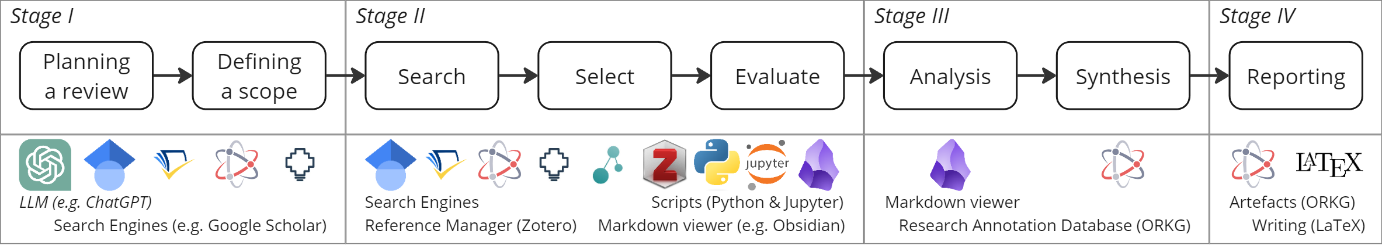
State of the Art
24.09.2024 • SWARM-SLR at TPDL • Tim Wittenborg
Notes:
How others define what needs to be done

Slide 5
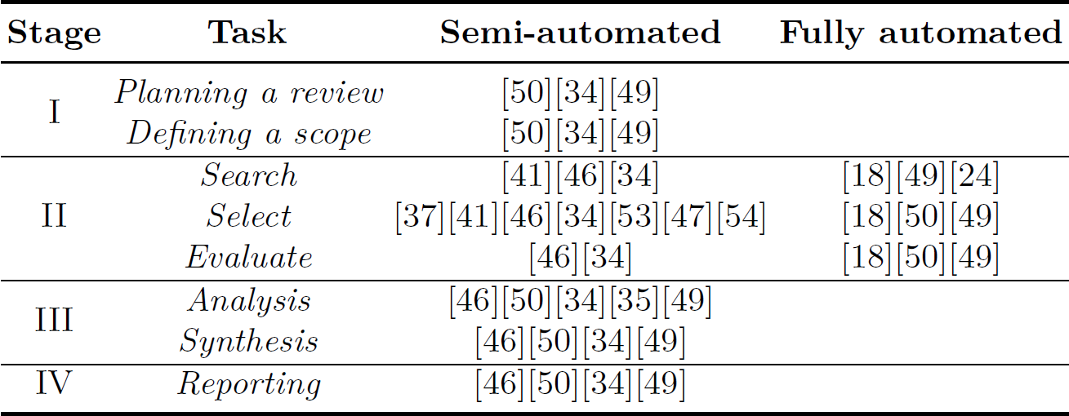
State of the Art: Everything can be supported
Mapping papers in relation to automation methods and SLR according to Pulsiri and Vatananan-Thesenvitz [1]
[1] Pulsiri, N., Vatananan-Thesenvitz, R.: Improving Systematic Literature Review with Automation and Bibliometrics. In: 2018 Portland International Conference on Management of Engineering and Technology (PICMET). pp. 1–8 (2018). https://doi.org/10.23919/PICMET.2018.8481746, ISSN: 2159-5100
24.09.2024 • SWARM-SLR at TPDL • Tim Wittenborg
Notes:
How others define what needs to be done

Slide 6
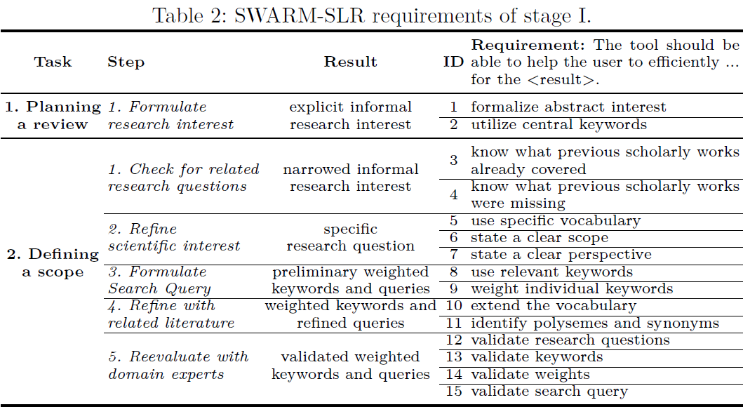
Specification: Task specific requirements
24.09.2024 • SWARM-SLR at TPDL • Tim Wittenborg

Slide 7
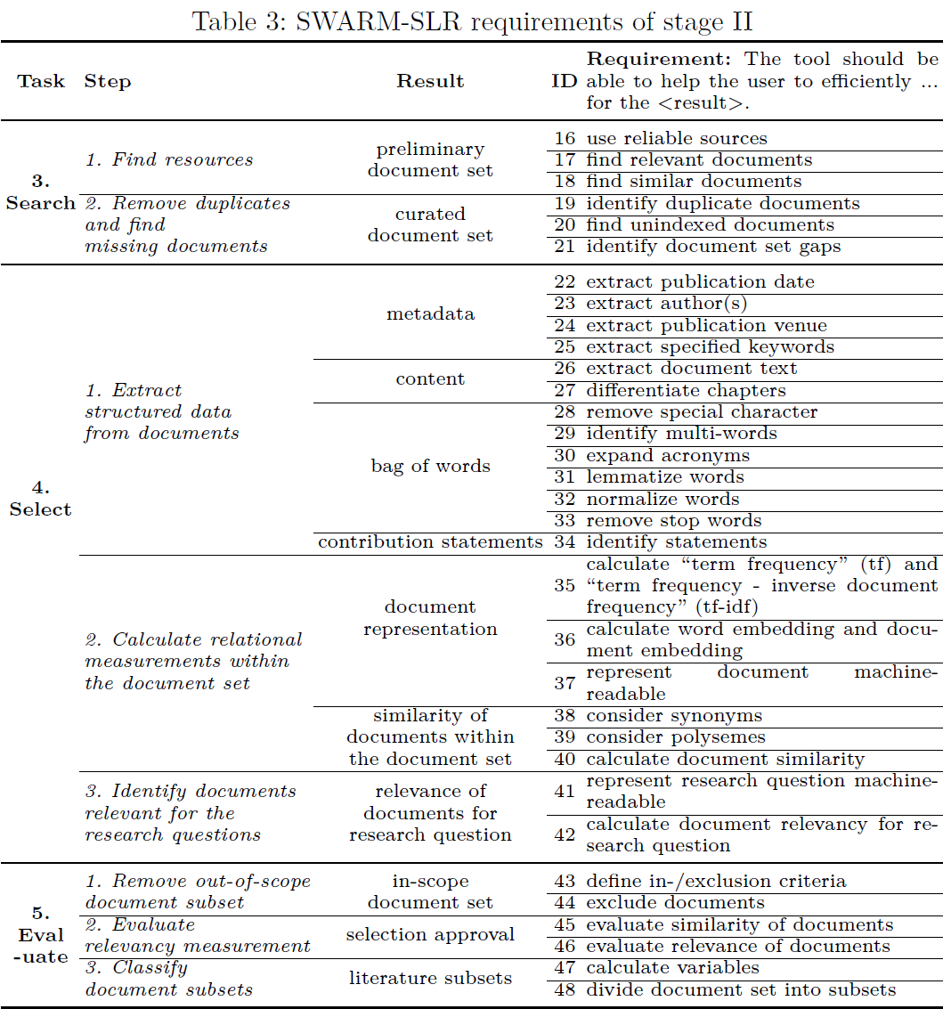
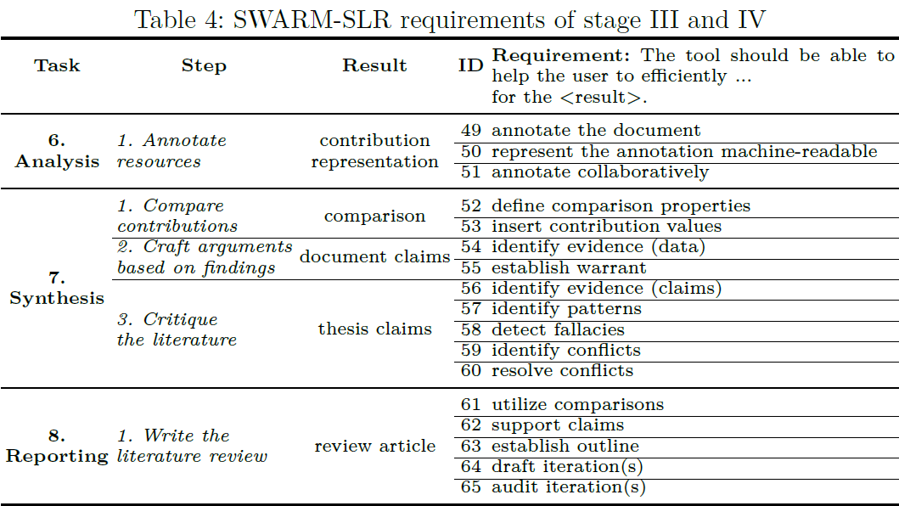
24.09.2024 • SWARM-SLR at TPDL • Tim Wittenborg
Notes:
We specify what this means exactly

Slide 8
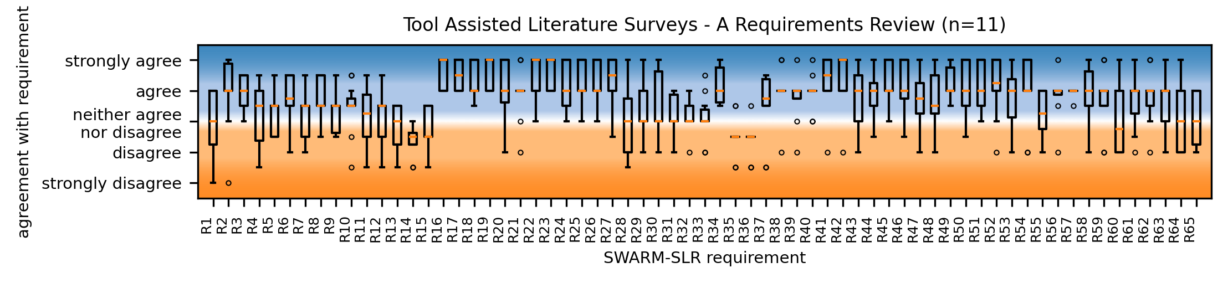
Evaluation: Requirements and Workflow
2. Defining a Scope
3. Search
4. Select
5. Evaluate
6. Ana-lysis
7. Synthesis
1. Planning a review
2. Defining a Scope
3. Search
4. Select
5. Evaluate
6. Ana-lysis
7. Synthesis
8. Reporting
Requirements largely confirmed
reserved skepticism towards a tool supporting Step 2.5 Reevaluate with domain experts (R12-R15)
No missing requirements reported
Survey ongoing and available online
Including responses, analysis code, visualizations, ...
24.09.2024 • SWARM-SLR at TPDL • Tim Wittenborg

Slide 9
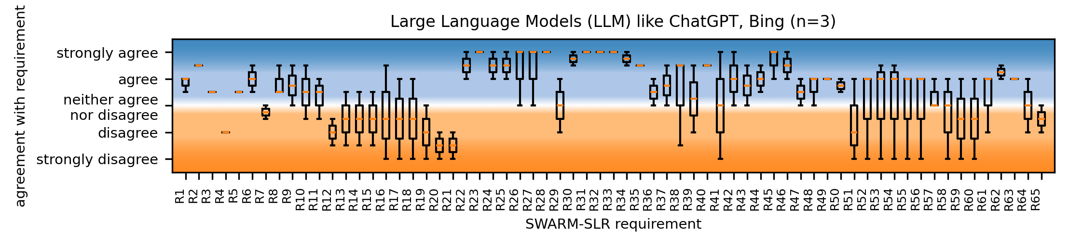
Tool evaluation: ChatGPT
asd
2. Defining a Scope
3. Search
4. Select
5. Evaluate
6. Ana-lysis
7. Synthesis
1. Planning a review
2. Defining a Scope
3. Search
4. Select
5. Evaluate
6. Ana-lysis
7. Synthesis
8. Reporting
Use requirements to measure task specific tool fitness
E.g. LLM like ChatGPT:
Strong in ideation, text extraction, writing
Weak in reliability and verification
24.09.2024 • SWARM-SLR at TPDL • Tim Wittenborg

Slide 10
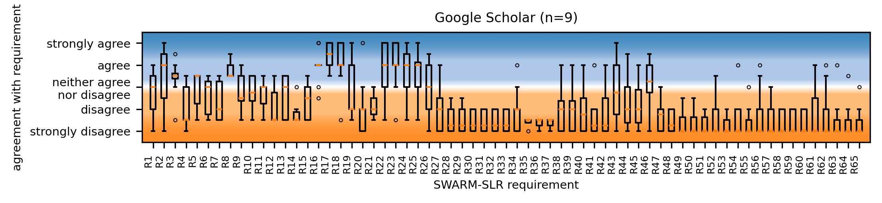
Tool evaluation: ChatGPT vs. Google Scholar
asd
2. Defining a Scope
3. Search
4. Select
5. Evaluate
6. Ana-lysis
7. Synthesis
2. Defining a Scope
3. Search
4. Select
5. Evaluate
6. Ana-lysis
7. Synthesis
1. Planning a review
2. Defining a Scope
3. Search
4. Select
5. Evaluate
6. Ana-lysis
7. Synthesis
8. Reporting
24.09.2024 • SWARM-SLR at TPDL • Tim Wittenborg

Slide 11
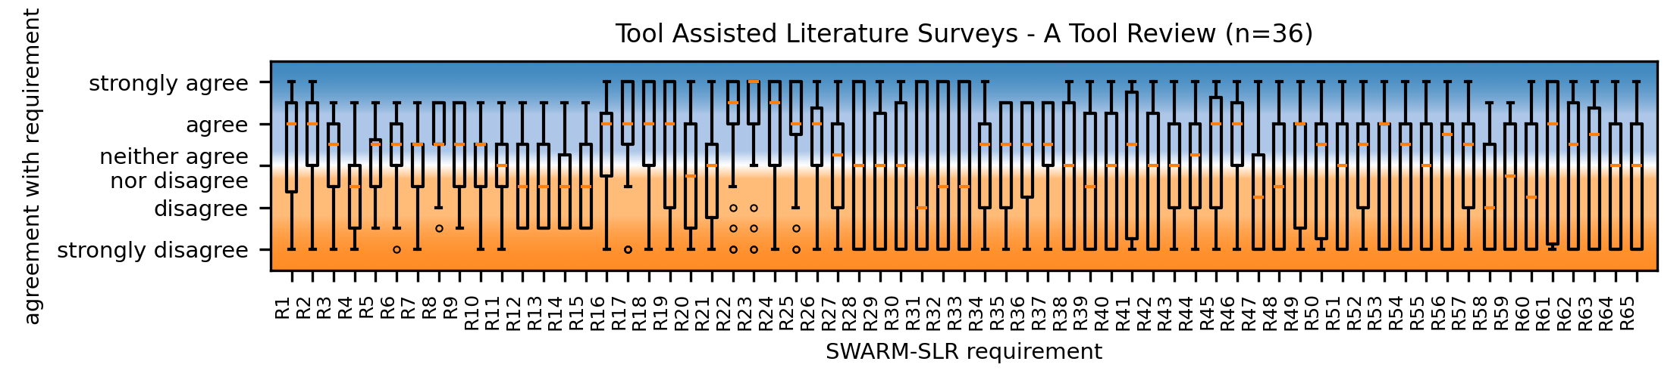
Evaluation: All tools
2. Defining a Scope
3. Search
4. Select
5. Evaluate
6. Ana-lysis
7. Synthesis
1. Planning a review
2. Defining a Scope
3. Search
4. Select
5. Evaluate
6. Ana-lysis
7. Synthesis
8. Reporting
Every requirement can be fulfilled by at least one tool
No tool meets all requirements alone
24.09.2024 • SWARM-SLR at TPDL • Tim Wittenborg

Slide 12
Evaluation: All tools
2. Defining a Scope
3. Search
4. Select
5. Evaluate
6. Ana-lysis
7. Synthesis
1. Planning a review
2. Defining a Scope
3. Search
4. Select
5. Evaluate
6. Ana-lysis
7. Synthesis
8. Reporting
Every requirement can be fulfilled by at least one tool
No tool meets all requirements alone
Next step: Chain the best fitted tools together!
24.09.2024 • SWARM-SLR at TPDL • Tim Wittenborg

Slide 13
Unified Workflow
Goals:
Build a modular, streamlined workflow
Fullfill all requirements with the „best“ tool available
easy to use, large community, accessible for free, interoperable, …
Workflow should be automated where possible, semi-automated human-in-the-loop where needed.
24.09.2024 • SWARM-SLR at TPDL • Tim Wittenborg

Slide 14
Unified Workflow: 4 Jupyter Notebooks
Goals:
Build a modular, streamlined workflow
Fullfill all requirements with the „best“ tool available
easy to use, large community, accessible for free, interoperable, …
Workflow should be automated where possible, semi-automated human-in-the-loop where needed.
24.09.2024 • SWARM-SLR at TPDL • Tim Wittenborg

Slide 15
Demonstration

Slide 16
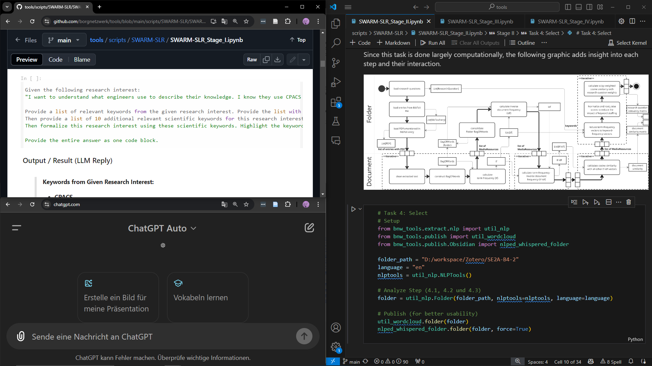
SWARM-SLR Workflow
(online)
SWARM-SLR Workflow
(local)
LLM

Slide 17
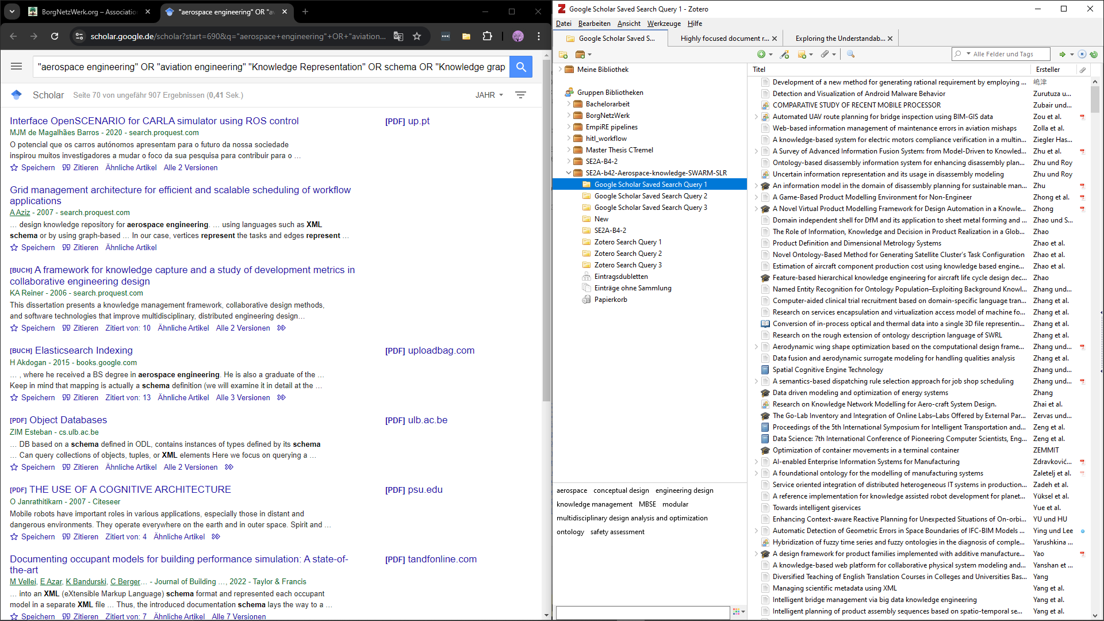
Search engine
(e.g. Google Scholar)
Reference manager (e.g. Zotero)

Slide 18
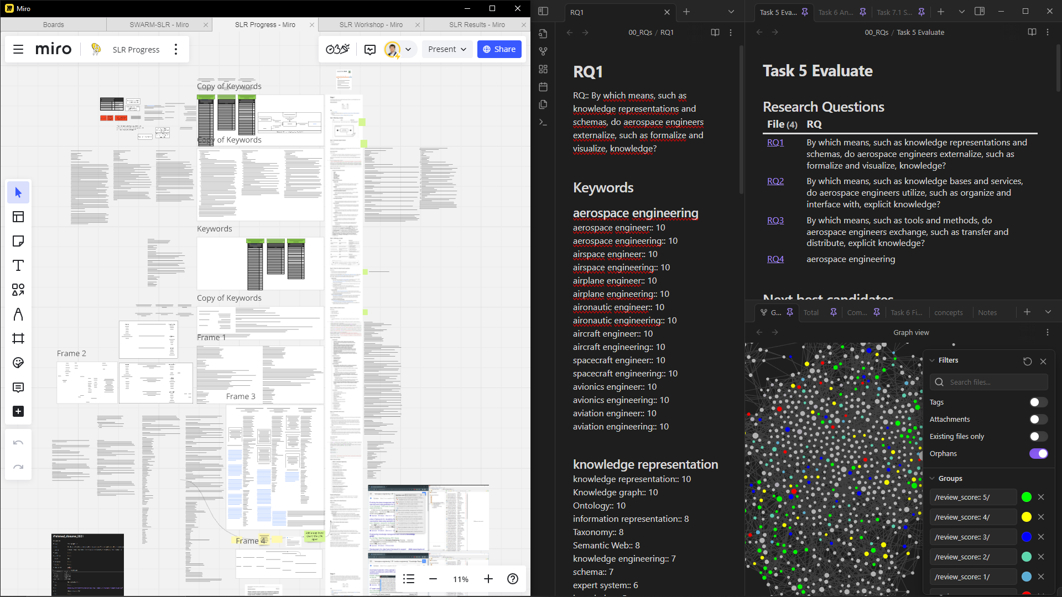
Noteboard
(e.g. Miro)
Markdown viewer
(e.g. Obsidian)

Slide 19
Demonstration
(not included in the Backup)

Slide 20
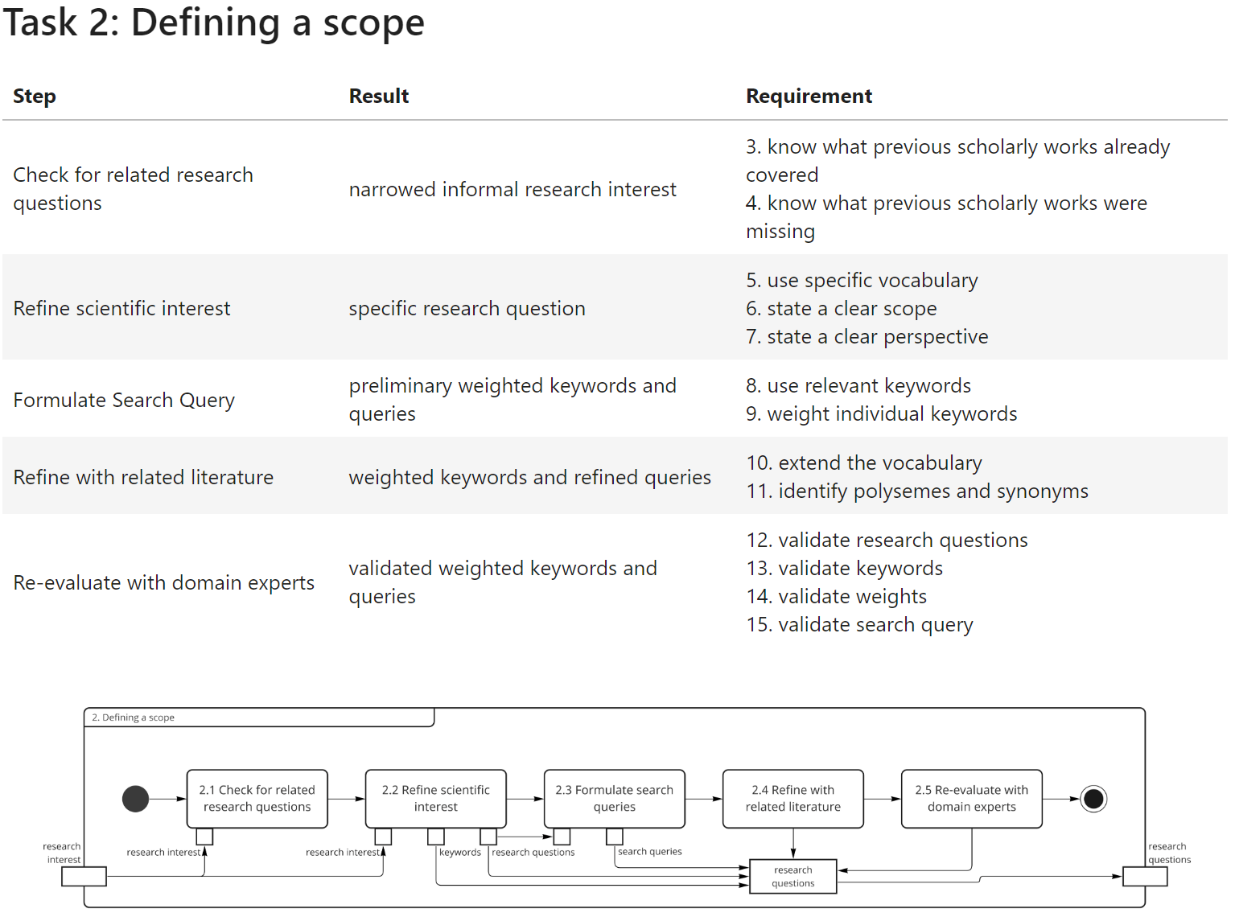
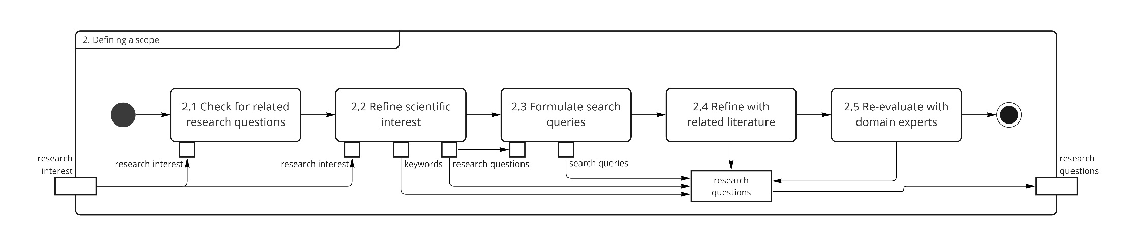
Stage I: Use LLM at their best
Formulate
Research questions
Keywords
Search queries
BUT: Validate with human expertes as well
24.09.2024 • SWARM-SLR at TPDL • Tim Wittenborg

Slide 21
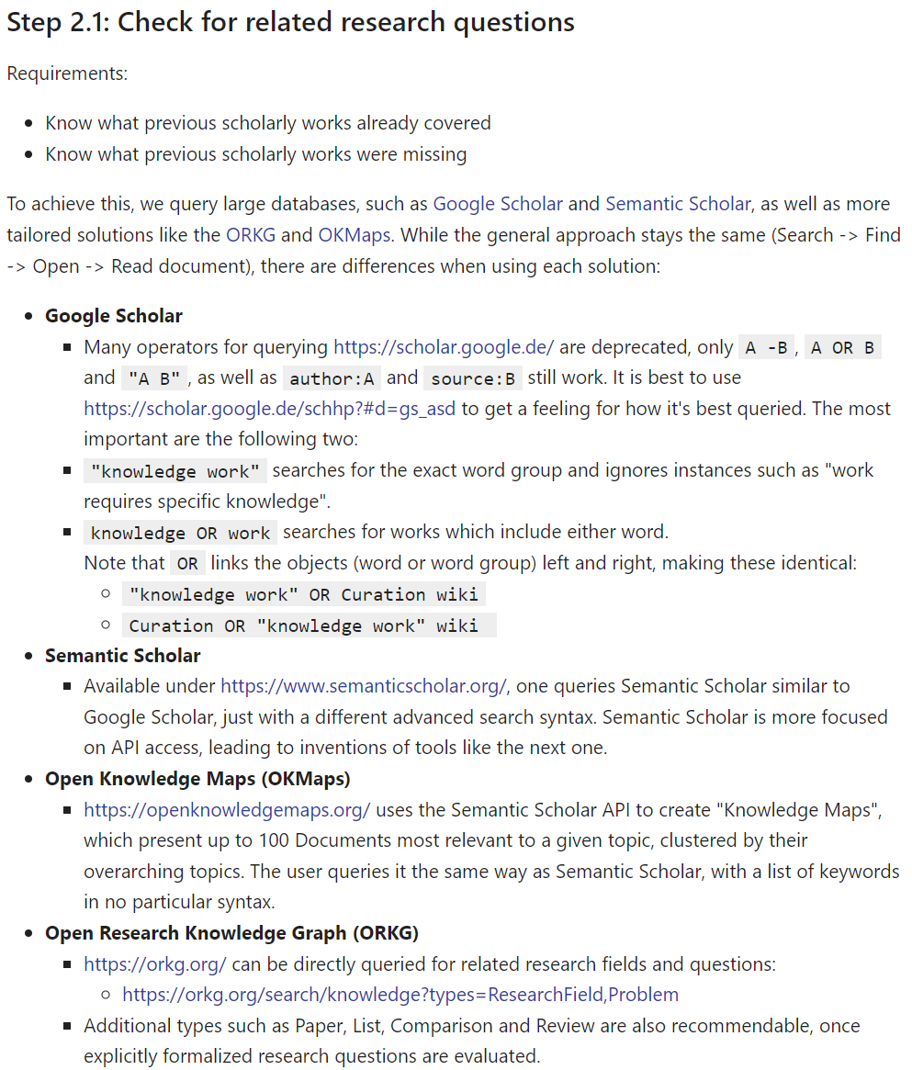
Stage I: Use LLM at their best
24.09.2024 • SWARM-SLR at TPDL • Tim Wittenborg

Slide 22
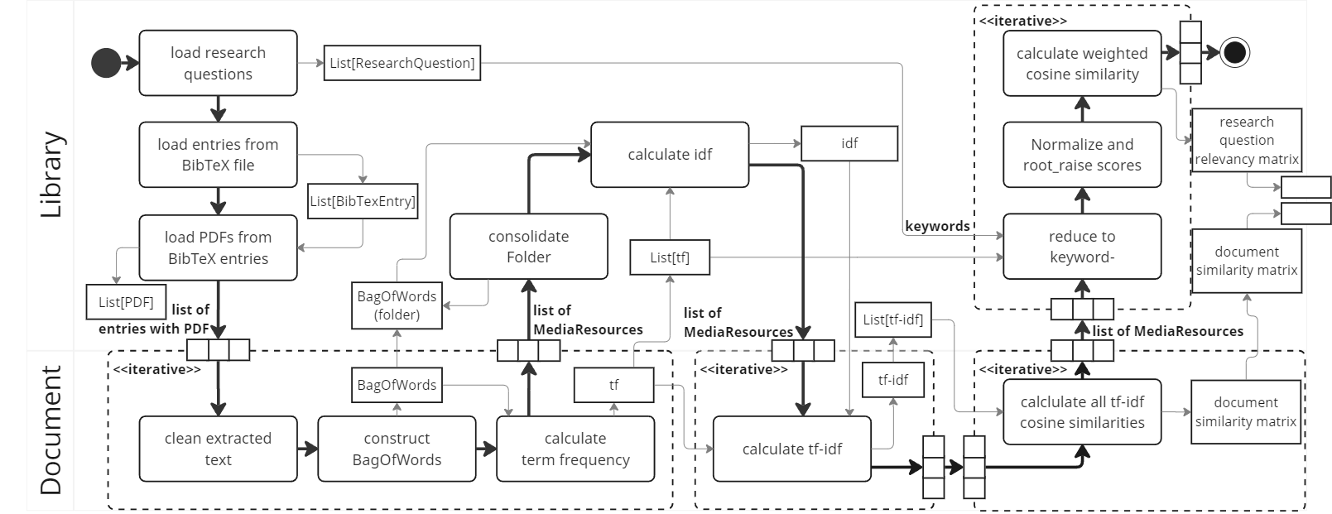
Stage II: Search, select and evaluate „fully automated“
BUT: Human evaluation still required.
24.09.2024 • SWARM-SLR at TPDL • Tim Wittenborg

Slide 23
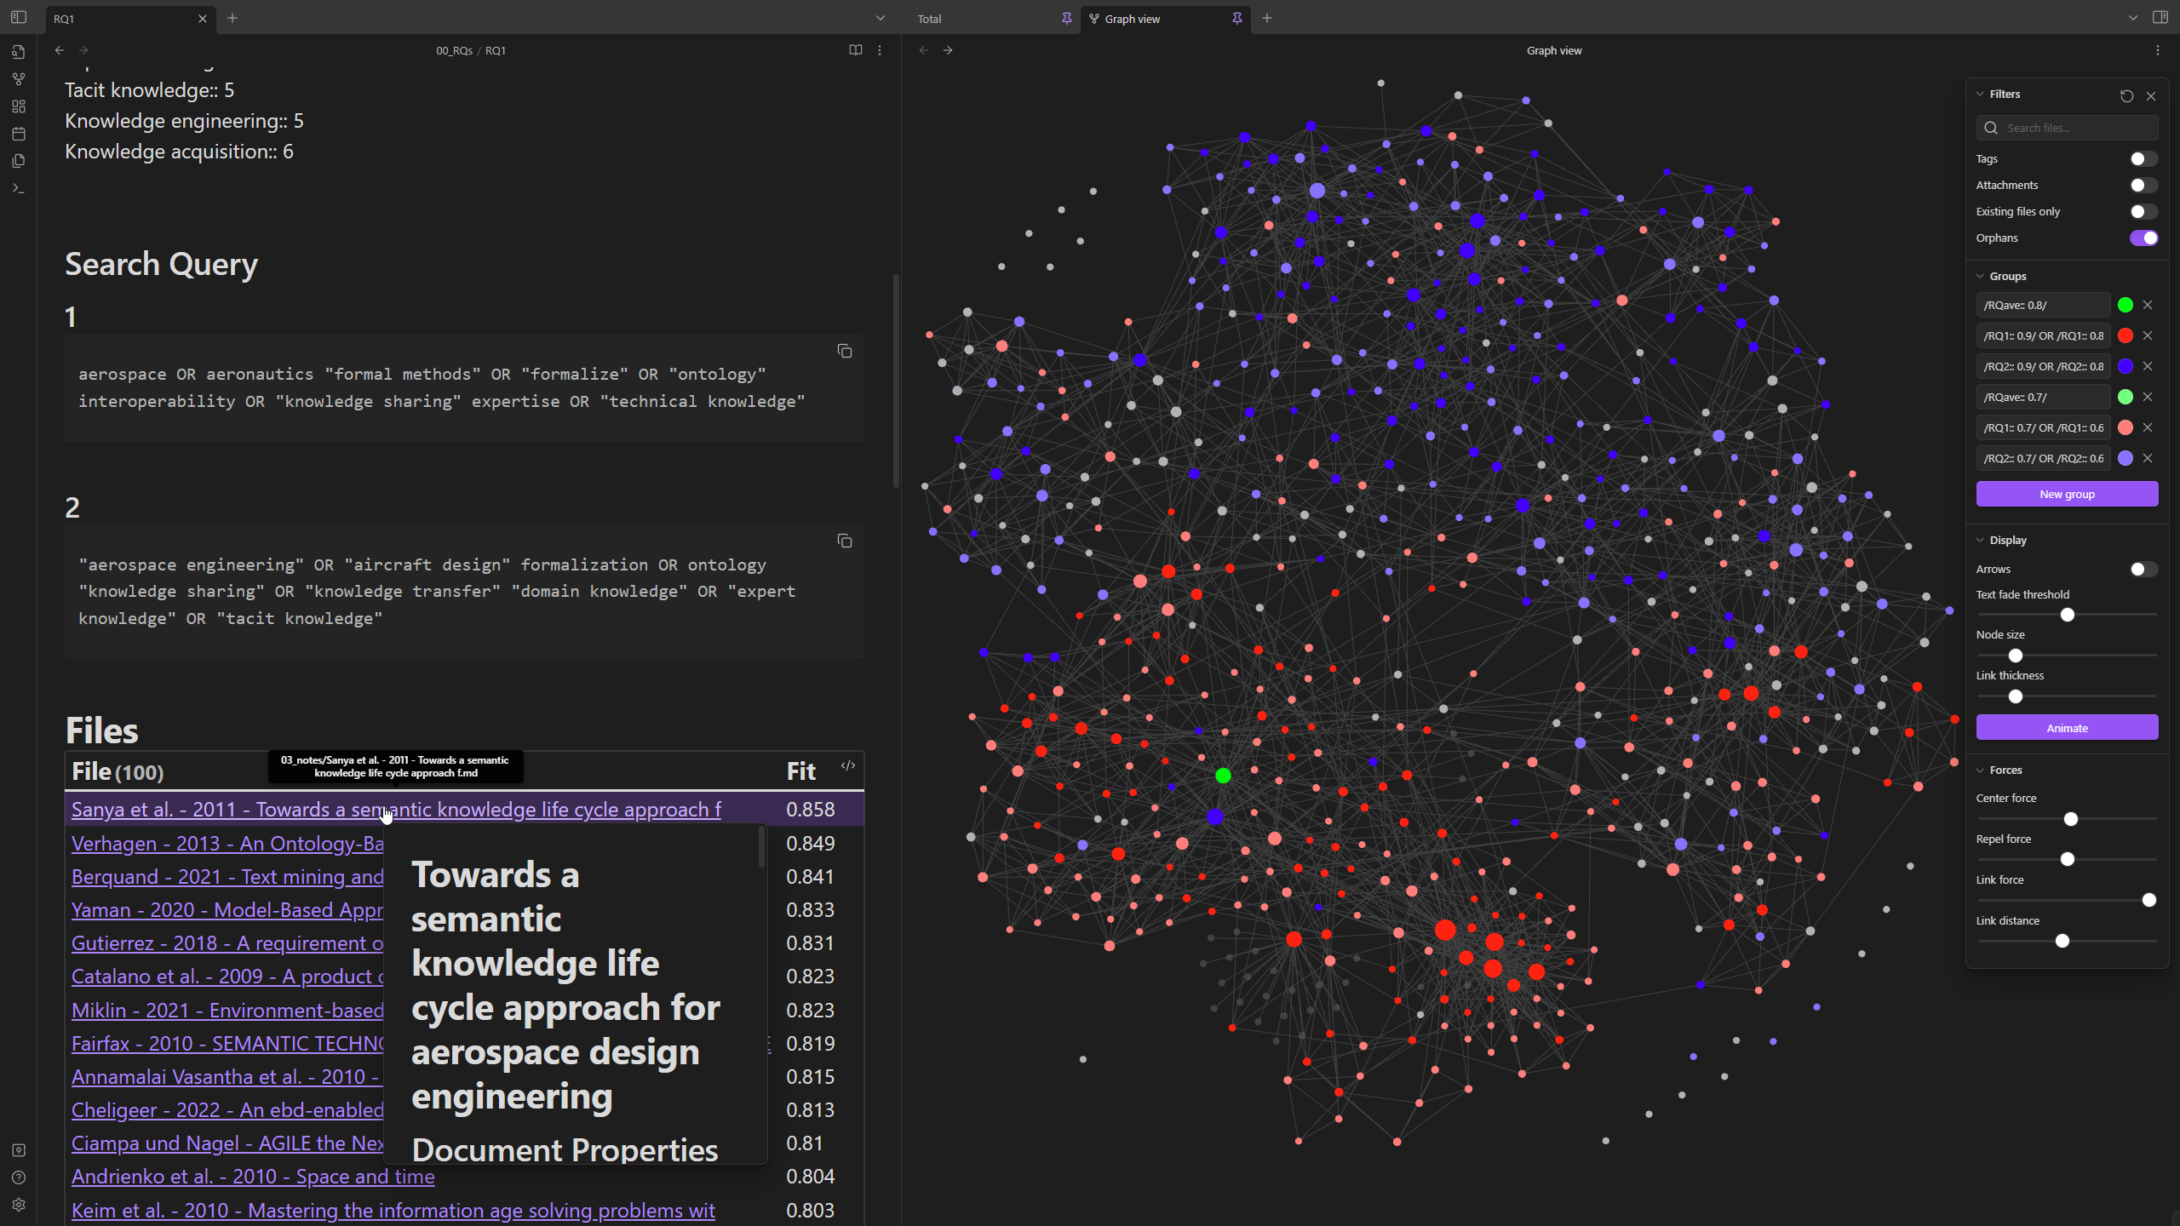
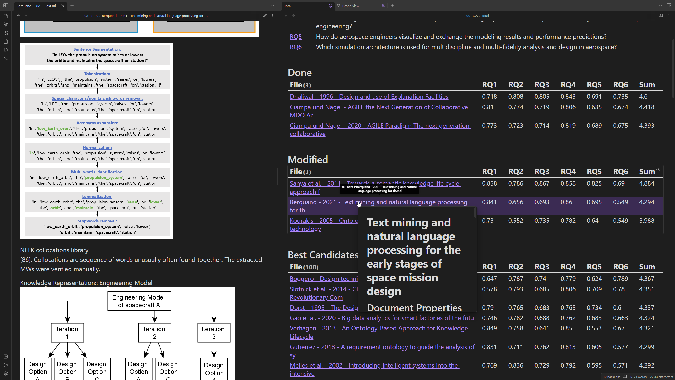
Stage III: Synthesis & Analysis: Don’t reinvent the wheel, use it.
24.09.2024 • SWARM-SLR at TPDL • Tim Wittenborg

Slide 24
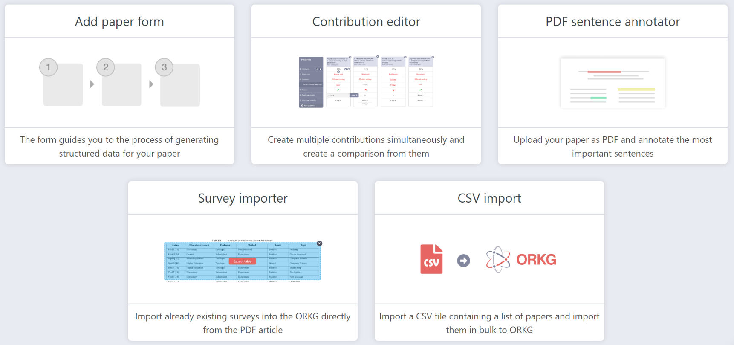
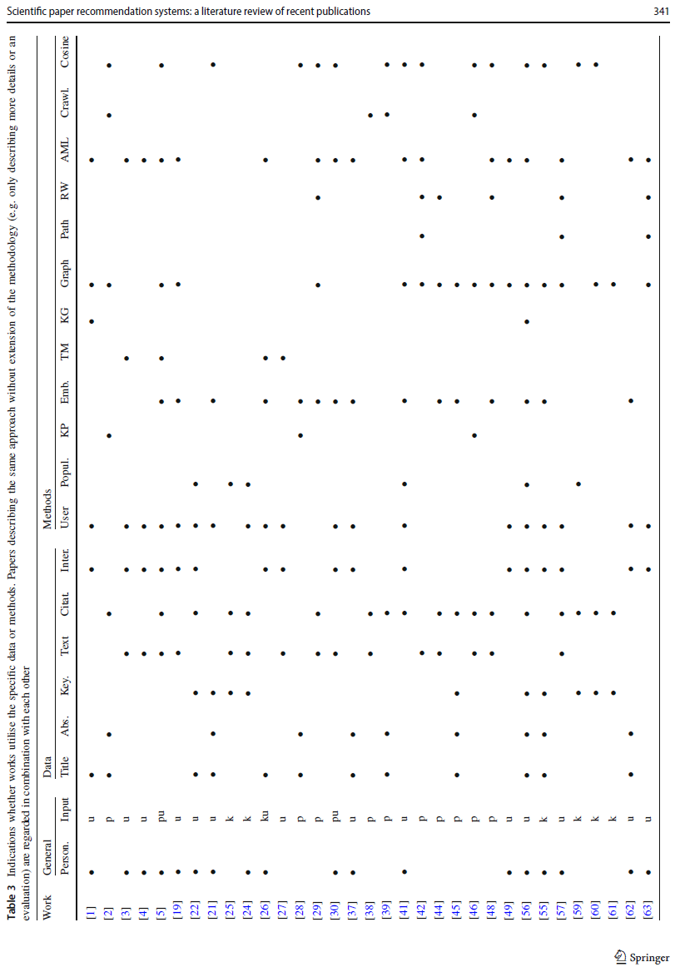
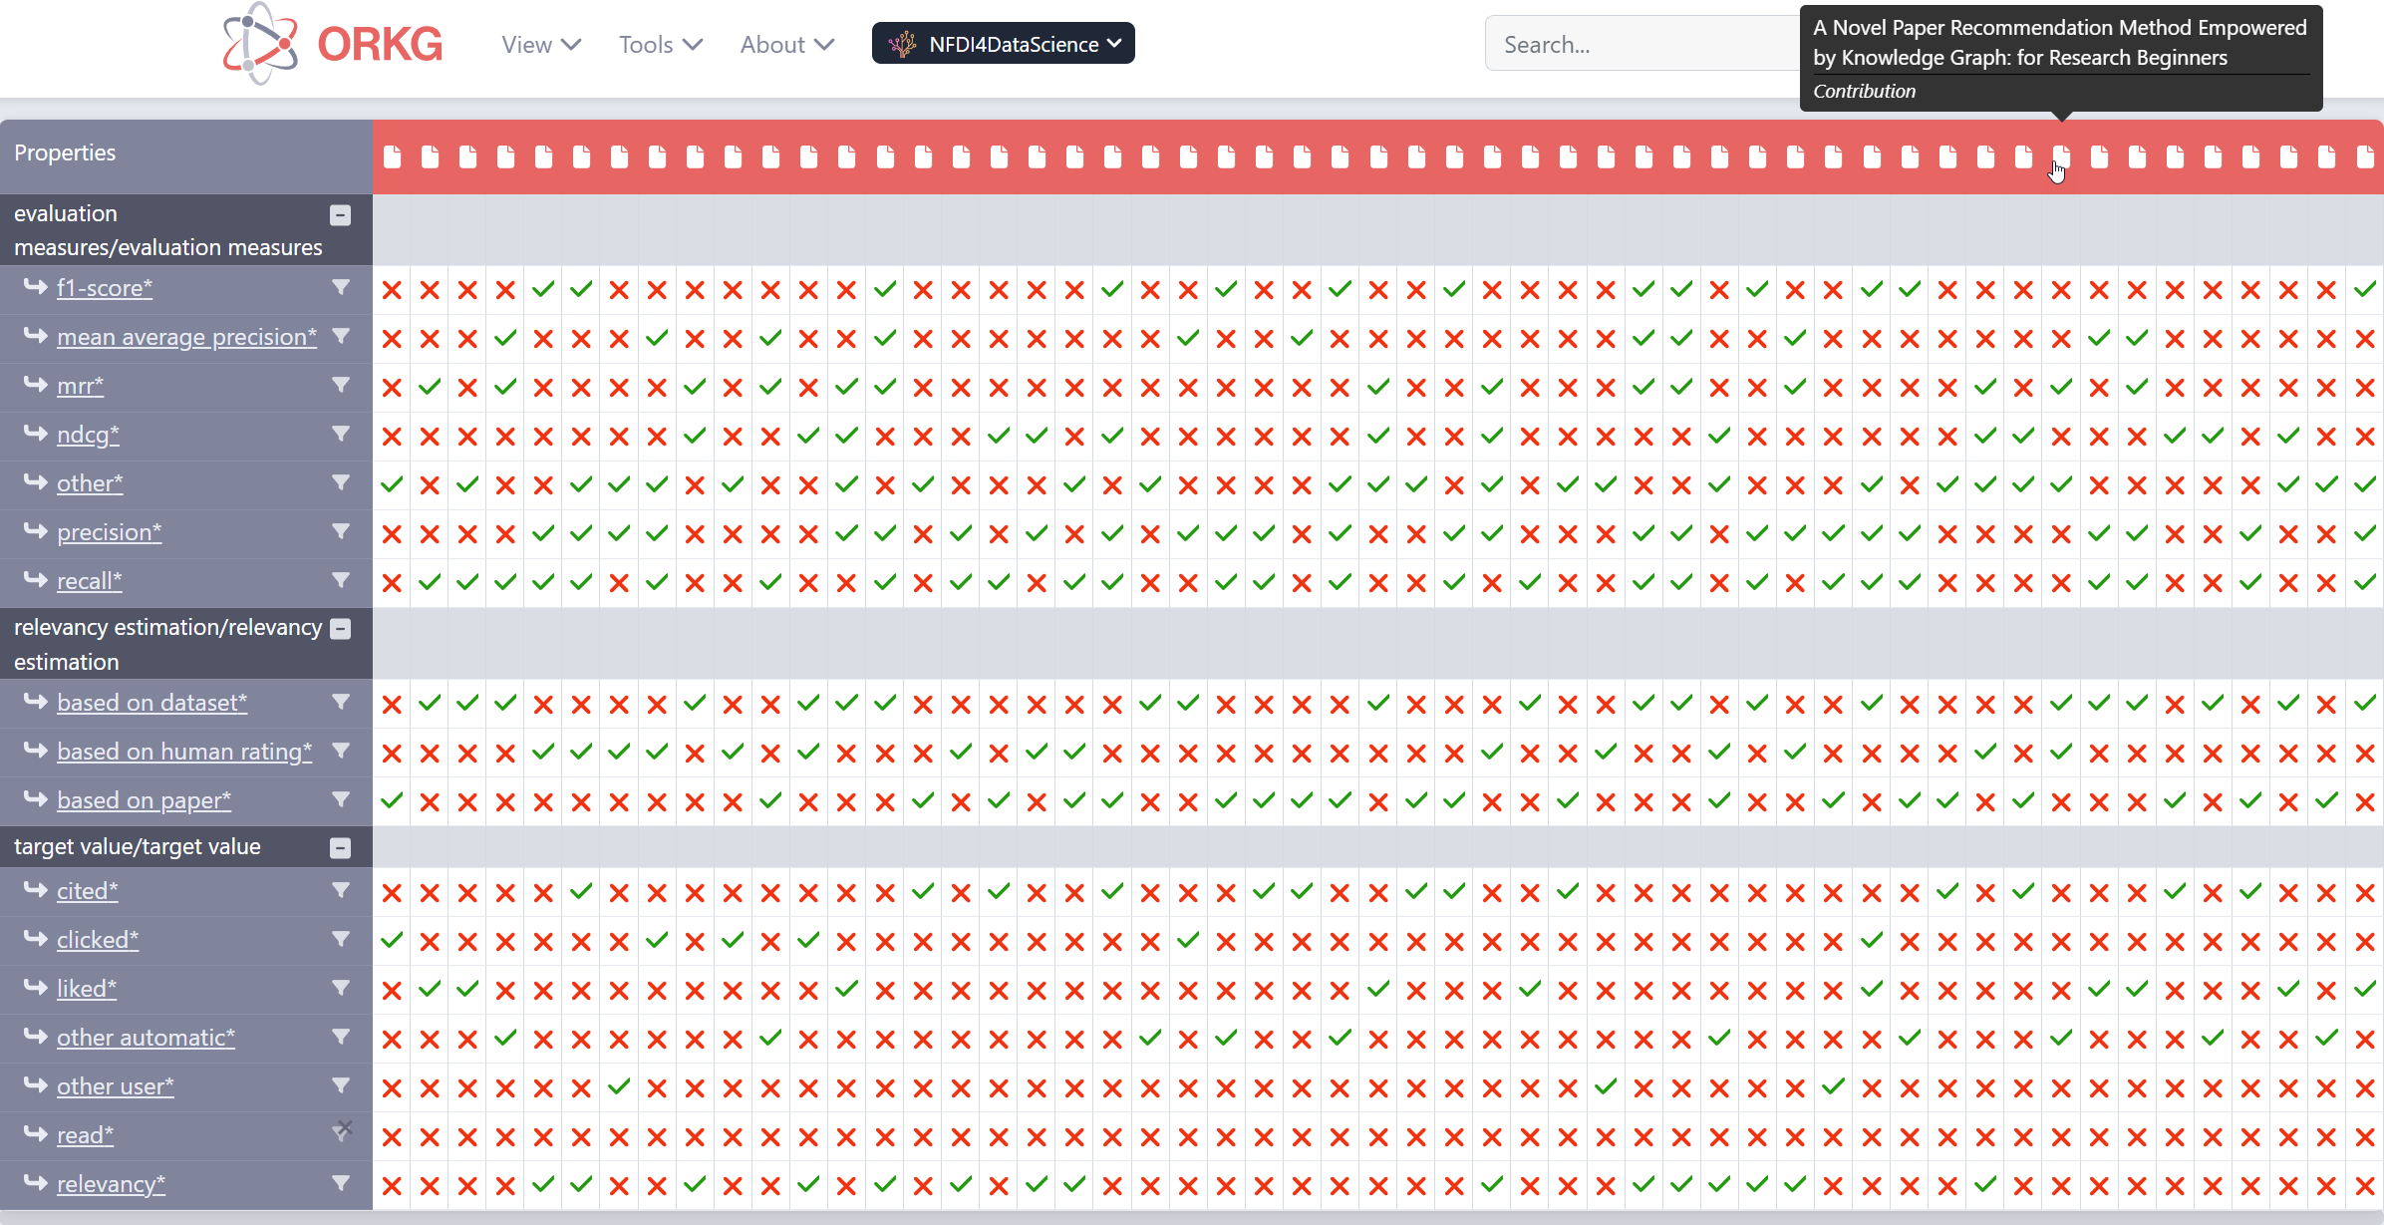
Stage IV: Reporting: machine-actionable reviews
[1] Kreutz, C.K., Schenkel, R.: Scientific paper recommendation systems: a literature review of recent publications. International Journal on Digital Libraries 23(4), 335–369 (Dec 2022). https://doi.org/10.1007/s00799-022-00339-w
24.09.2024 • SWARM-SLR at TPDL • Tim Wittenborg

Slide 25

Workflow: From a question to a complete Review
From research question
24.09.2024 • SWARM-SLR at TPDL • Tim Wittenborg

Slide 26
Evaluation: All tools and the SWARM-SLR Workflow
2. Defining a Scope
3. Search
4. Select
5. Evaluate
6. Ana-lysis
7. Synthesis
1. Planning a review
2. Defining a Scope
3. Search
4. Select
5. Evaluate
6. Ana-lysis
7. Synthesis
8. Reporting
24.09.2024 • SWARM-SLR at TPDL • Tim Wittenborg

Slide 27
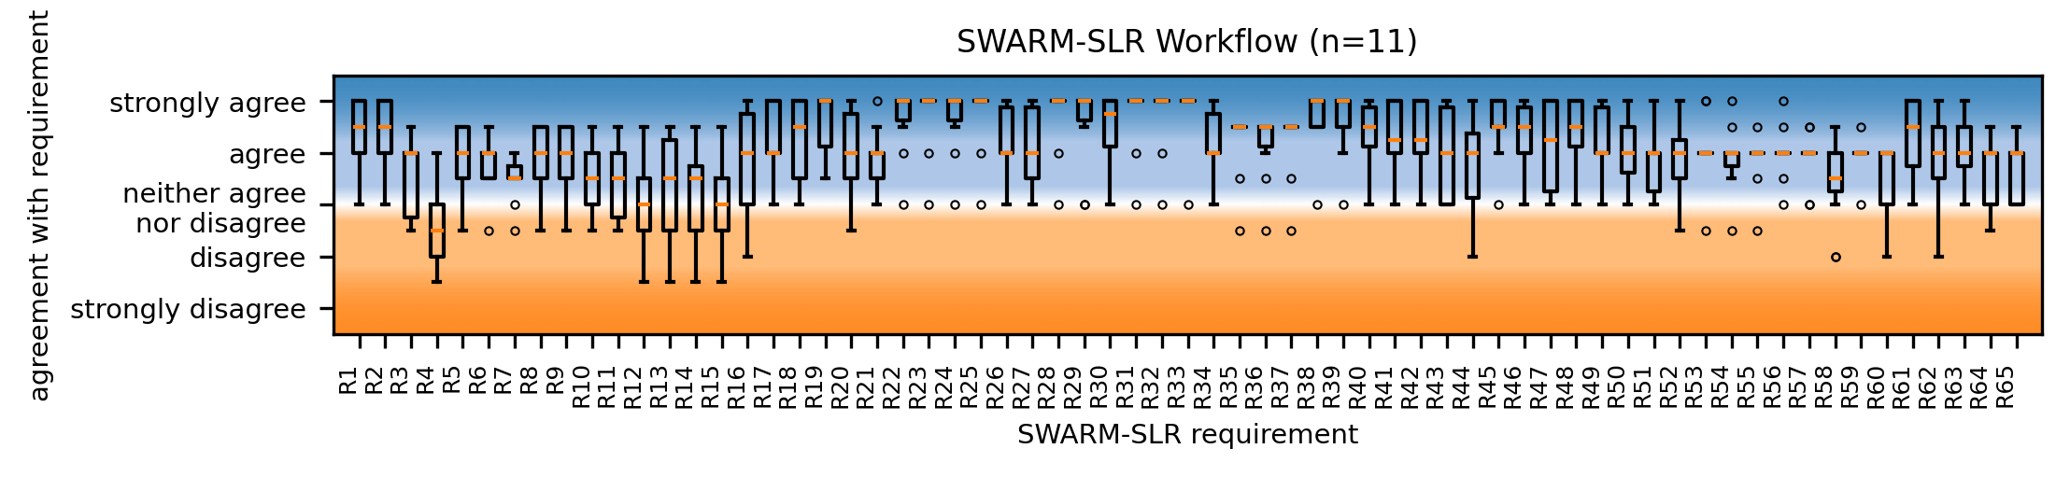
Evaluation: All tools and the SWARM-SLR Workflow
2. Defining a Scope
3. Search
4. Select
5. Evaluate
6. Ana-lysis
7. Synthesis
1. Planning a review
2. Defining a Scope
3. Search
4. Select
5. Evaluate
6. Ana-lysis
7. Synthesis
8. Reporting
24.09.2024 • SWARM-SLR at TPDL • Tim Wittenborg

Slide 28
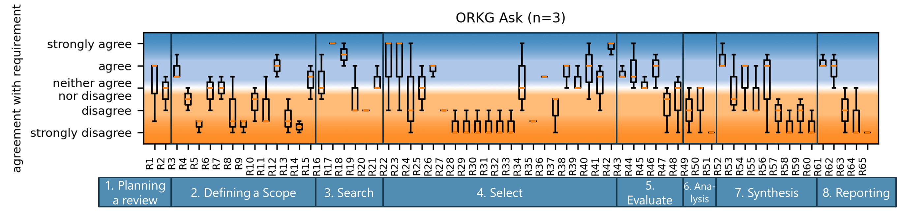
Future work: update, update, update
During the writing of this, ...
The „Systematic Literature Review Toolbox“ went offline since March 2024 [1]
ORKG Ask was released on April 2024 [2]
More tools will be developed, more requirements raised
[1] https://web.archive.org/web/20240000000000*/https://www.systematicreviewtools.com/
[2] https://ask.orkg.org/
24.09.2024 • SWARM-SLR at TPDL • Tim Wittenborg

Slide 29
Future work: update, update, update
During the writing of this, ...
The „Systematic Literature Review Toolbox“ went offline since March 2024 [1]
ORKG Ask was released on April 2024 [2]
More tools will be developed, more requirements raised
We need more ...
Requirement evaluation and detail differenciation [3]
Tool assessments and suggestions [3]
Workflow eveluation and updates [3]
Field testing and user feedback [3]
[3]
[1] https://web.archive.org/web/20240000000000*/https://www.systematicreviewtools.com/
[2] https://ask.orkg.org/
24.09.2024 • SWARM-SLR at TPDL • Tim Wittenborg

Slide 30
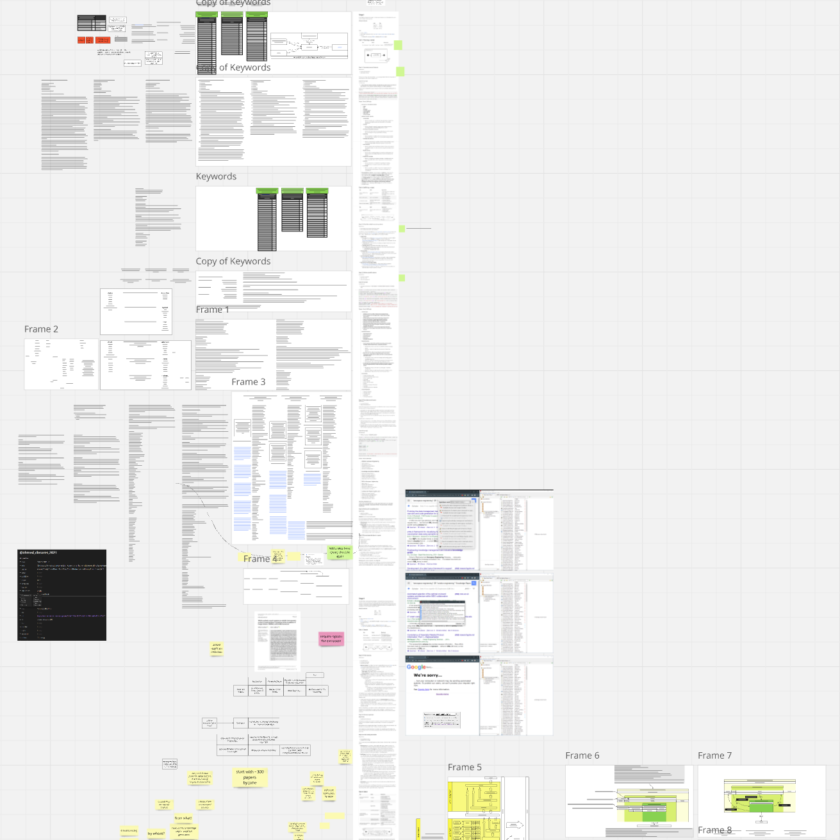
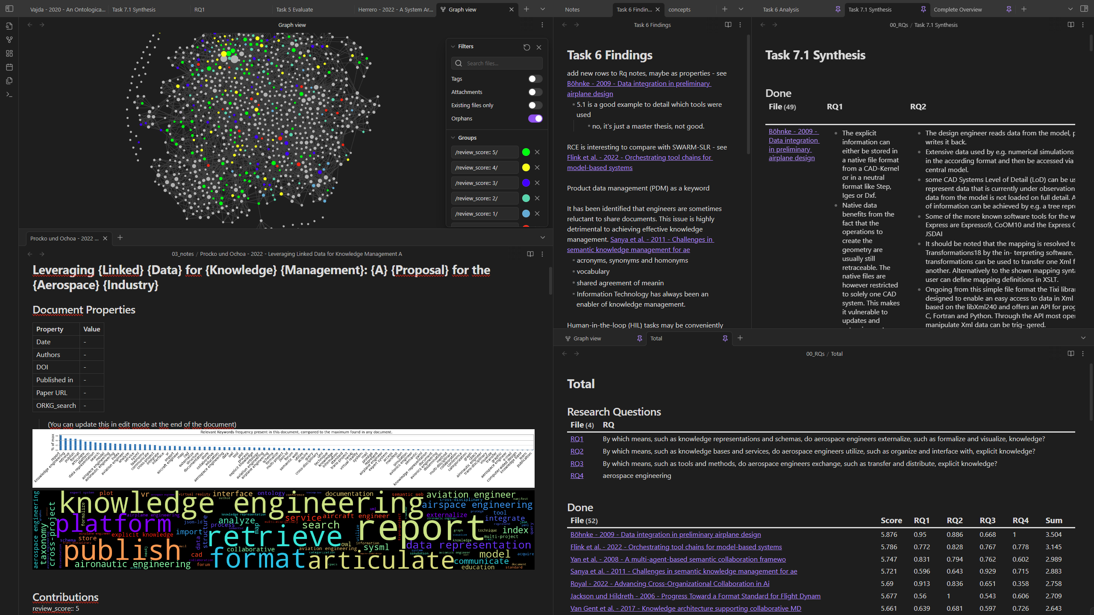
Future work: Using SWARM-SLR to conduct real SLR
Ongoing SWARM-SLR
24.09.2024 • SWARM-SLR at TPDL • Tim Wittenborg

Slide 31
Conclusion: Collaborate, coordinate, and conquer the literature flood
65 Requirements specified
1 modular Workflow synthesizd
Ready-to-use SWARM-SLR, but no full SRA
11 Tools assessed
24.09.2024 • SWARM-SLR at TPDL • Tim Wittenborg

Slide 32
Tim Wittenborg
tim.wittenborg@l3s.de

